Slide 1
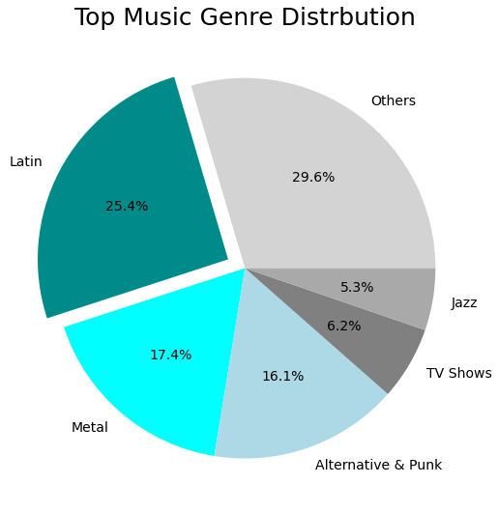
Top Music Genre Distribution
Visualization
Description
Since the rock genre is
dominating sales in every
country; it's a good idea to
explore a less competitive genre to expand our sales
Question:
What genres are making above average sales , which are no rock?
Bonus:
Bin all below average genres
Conclusion:
Latin, metal and punk are prime candidates to focus marketing on

Slide 2
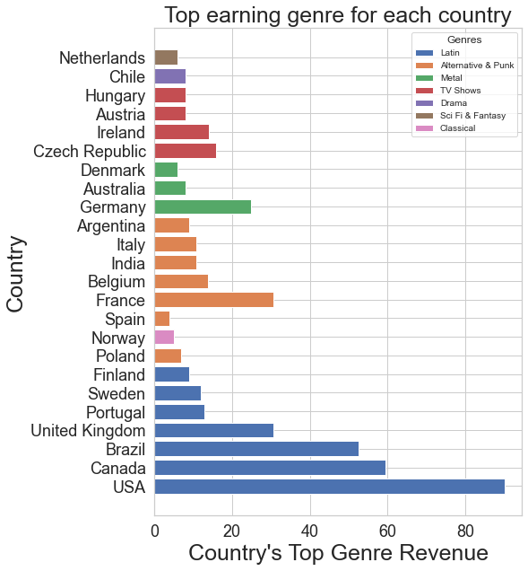
Best Genre In Each Country
Visualization
Description
Lets explore the top genre for every country in the dataset
Question:
What is the top genre for every country in the data set excluding Rock?
Conclusion:
Again Latin and Punk are very popular and are top performers in more than 5 countries each; however, metal isn’t as widely popular.

Slide 3
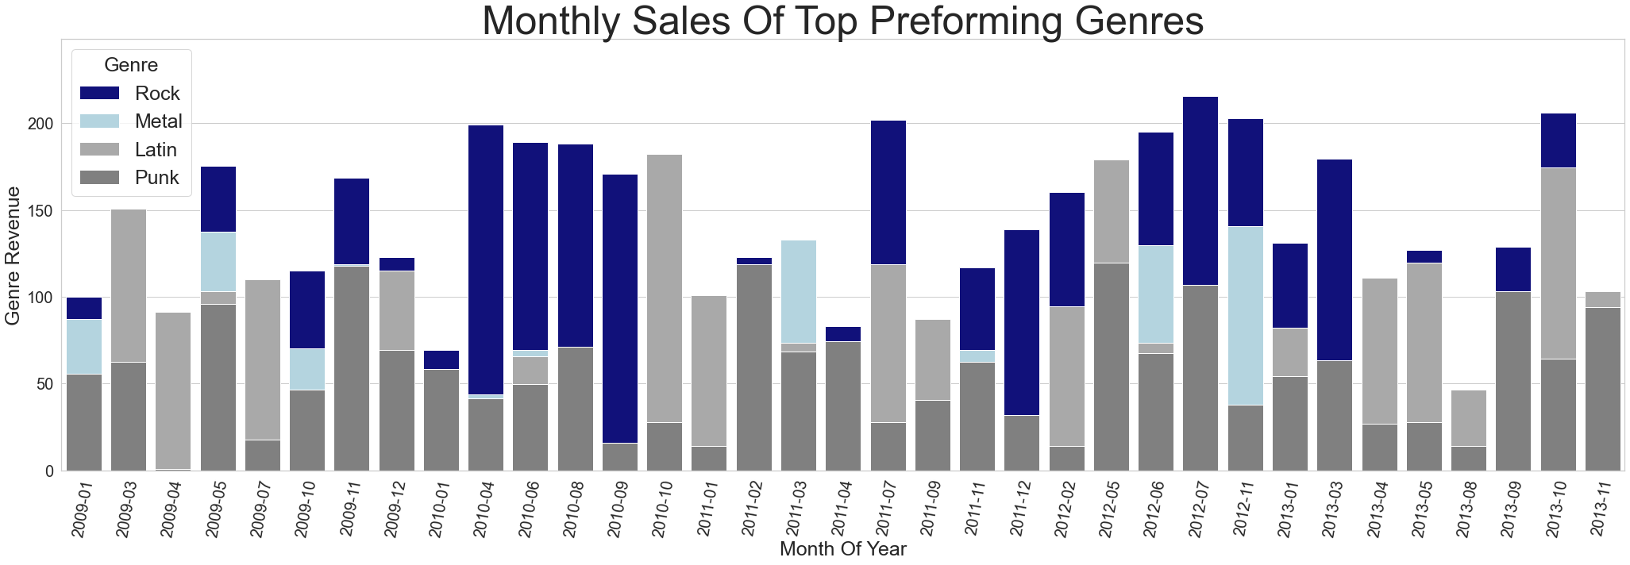
Top Music Genre Monthly Performance
Visualization
Description
Exploring the monthly performance of top earning genres
Question:
What is the monthly revenue over the duration of the dataset for the above average earning genres ?
Conclusion:
Rock, Metal, and Latin earn more than punk; However, Punk is a more reliable and consistent revenue stream with sales in all months but one.

Slide 4
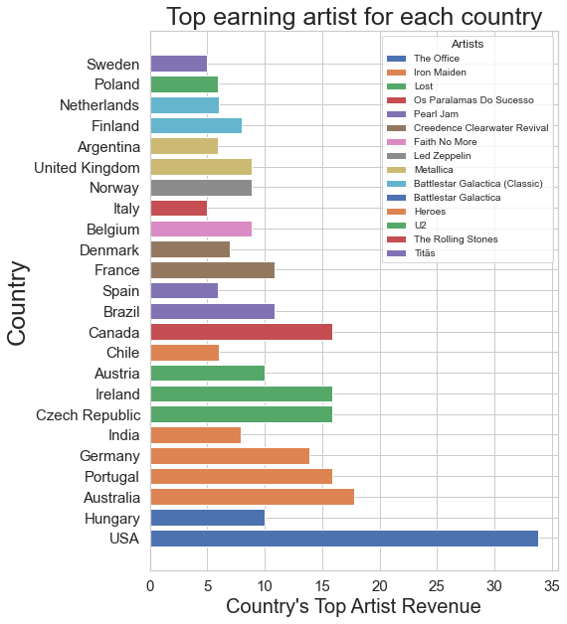
Top Artist In Each Country
Visualization
Description
Lets explore the top artist for every country in the dataset
Question:
Who is the top artist for every country in the data set?
Conclusion:
Iron maiden is very popular in 5 countries while U2 is popular in 3. the office is very popular in the USA. Most artists are popular in 1 or 2 countries only

